Slide 1
Securing and consuming a Web API with OAuth

Slide 2






Slide 3
Agenda
Claims-based auth
OAuth 2.0
OpenID Connect
Identity Server 3
Our setup for today

Slide 4
Claims-based auth
Past
FormsAuthentication: GenericPrincipal / FormsIdentity
Windows Authentication: WindowsPrincipal / WindowsIdentity
ClaimsPrincipal / ClaimsIdentity
Claims: information about someone by an IDP

Slide 5
OAuth 2.0
Improves v1
Shorter token lifetime (refresh tokens)
Works better in non-browser scenario’s
Authorization (what can I do)
Not authentication (who am I)

Slide 6
OpenID Connect
Describes an identity layer on top of OAuth 2.0
Grants access to the id_token

Slide 7
IdentityServer 3
https://identityserver.github.io/Documentation/
Install-Package IdentityServer3
Not the one called ThinkTecture.IdentityServer3!
Implements OpenID Connect and OAuth 2.0
Easy to set up

Slide 8
Our setup for today
Implicit flow
Doesn’t allow us to get a refresh token
Authorization code flow
Not supposed to be used for client applications
=> Hybrid flow
Requests access and refresh tokens (using a authorization code)
Allows us to store the refresh token to keep a user logged on

Slide 9
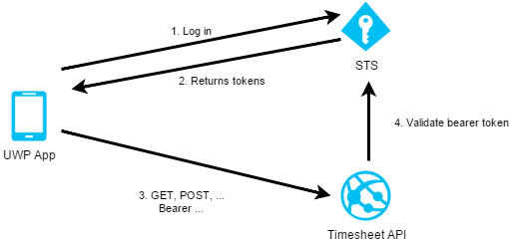
Our setup for today

Slide 10
Code

Slide 11
Terminology
IDP: Identity Provider
A service which provides information about our users
Trusted
STS: Security Token Service
A service which generates tokens for authentication and authorization purposes
Gets identity using one or more IDP’s
Trusted
RP: Relying Party
A service which communicates with an STS when an unauthorized user connects

Slide 12
Terminology
Claim
Statement about an entity made by someone else, like an identity provider
name, address, superpowers, …
JWT: JSON Web Token
Easy method of transferring identity information over the wire(less)
http://jwt.io – to inspect tokens
Install-Package System.IdentityModel.Tokens.Jwt
Resource owner
You
Resource server
The application or API who wants to use your identity to access your protected resources

Slide 13
Nuget packages
STS
IdentityServer3 Contains the STS middleware
Web API
IdentityServer3.AccessTokenValidation Used to configure Bearer token authentication
System.IdentityModel.Tokens.Jwt To clear the inbound claimtype mapping
UWP app
IdentityModel Helps you with the OAuth 2.0 / OpenID Connect processes by providing AuthorizeRequest, AuthorizeResponse, TokenClient, TokenResponse, UserInfoClient, …

